Slide 1
CSE214 – Analysis of Algorithms PhD Furkan Gözükara, Toros University https://github.com/FurkanGozukara/Analysis-of-Algorithms-2019
Lecture 7
Heapsort
Based on Ching‐Chi Lin’s Lecture Notes - National Taiwan Ocean University
Based on Cevdet Aykanat’s and Mustafa Ozdal’s Lecture Notes - Bilkent

Slide 2

Outline
` Heaps
` Maintaining the heap property
` Building a heap
` The heapsort algorithm
` Priority queues

Slide 3
The purpose of this chapter
` In this chapter, we introduce the heapsort algorithm.
` with worst case running time O(nlgn)
` an in‐place sorting algorithm: only a constant number of array
elements are stored outside the input array at any time.
` thus, require at most O(1) additional memory
` We also introduce the heap data structure.
` an useful data structure for heapsort
` makes an efficient priority queue

Slide 4
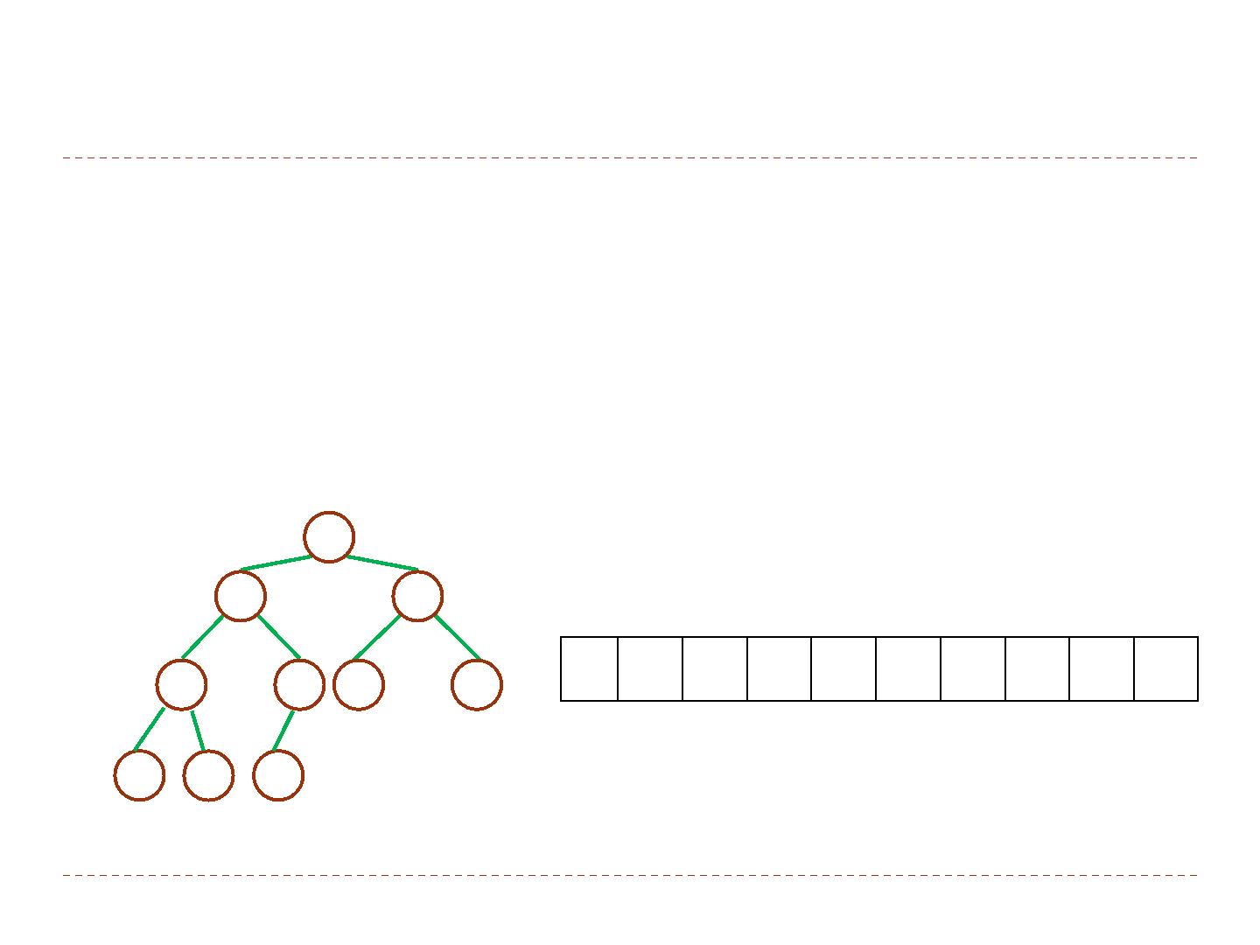
Heaps
` The (Binary) heap data structure is an array object that can be viewed as a nearly complete binary tree.
` A binary tree with n nodes and depth k is complete if its nodes
correspond to the nodes numbered from 1 to n in the full binary
tree of depth k.
1
2
16
3
14
10
1 2 3 4 5 6 7 8 9 10
16 14 10 8 7 9 3 2 4 1
4
8
5 6
7 9
7
3
8
9
10
2 4 1

Slide 5
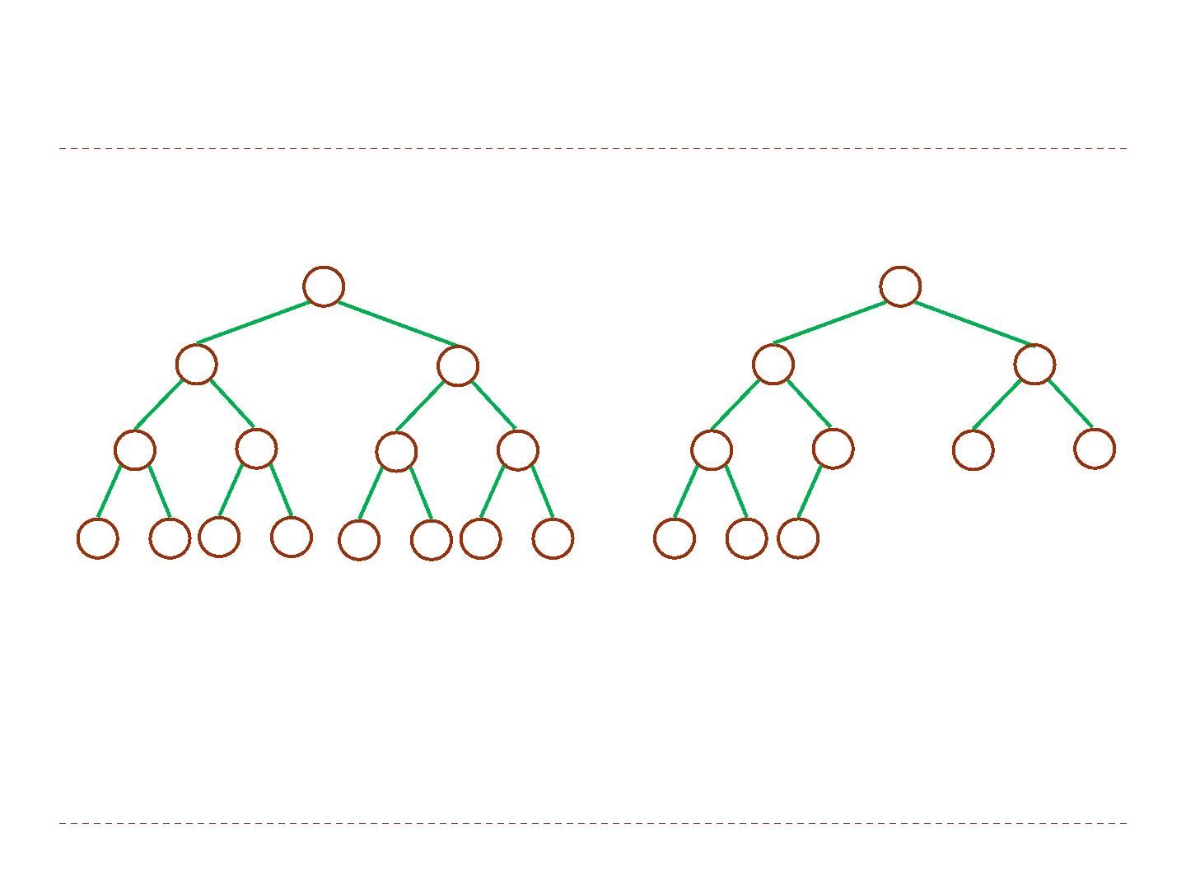
Binary tree representations
1
1
2
3
2
3
4
5
6
7
4
5
6
7
13
14
15
8
9 10 11 12
A full binary tree of height 3.
8
9 10
A complete binary tree with 10 nodes
and height 3.

Slide 6
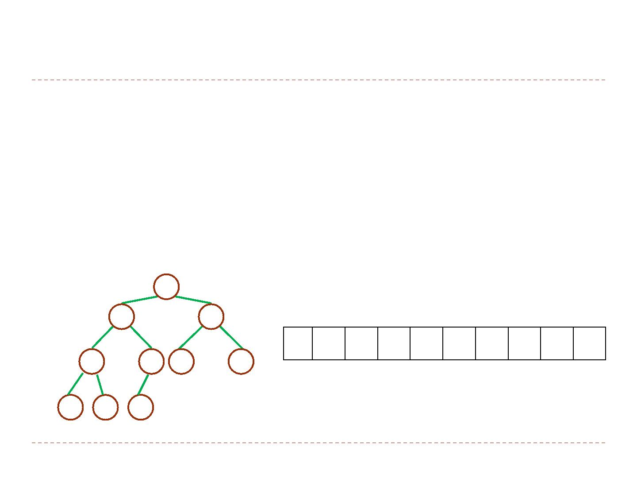
Attributes of a Heap
` An array A that presents a heap with two attributes:
` length[A]: the number of elements in the array.
` heap‐size[A]: the number of elements in the heap stored with
array A.
` length[A] ≥ heap‐size[A]
1
2
16
3
14
10
1 2 3 4 5 6 7 8 9 10
16 14 10 8 7 9 3 2 4 1
4
8
5 6
7 9
7
3
8
9
10
length[A] = heapsize[A] = 10
2 4 1

Slide 7
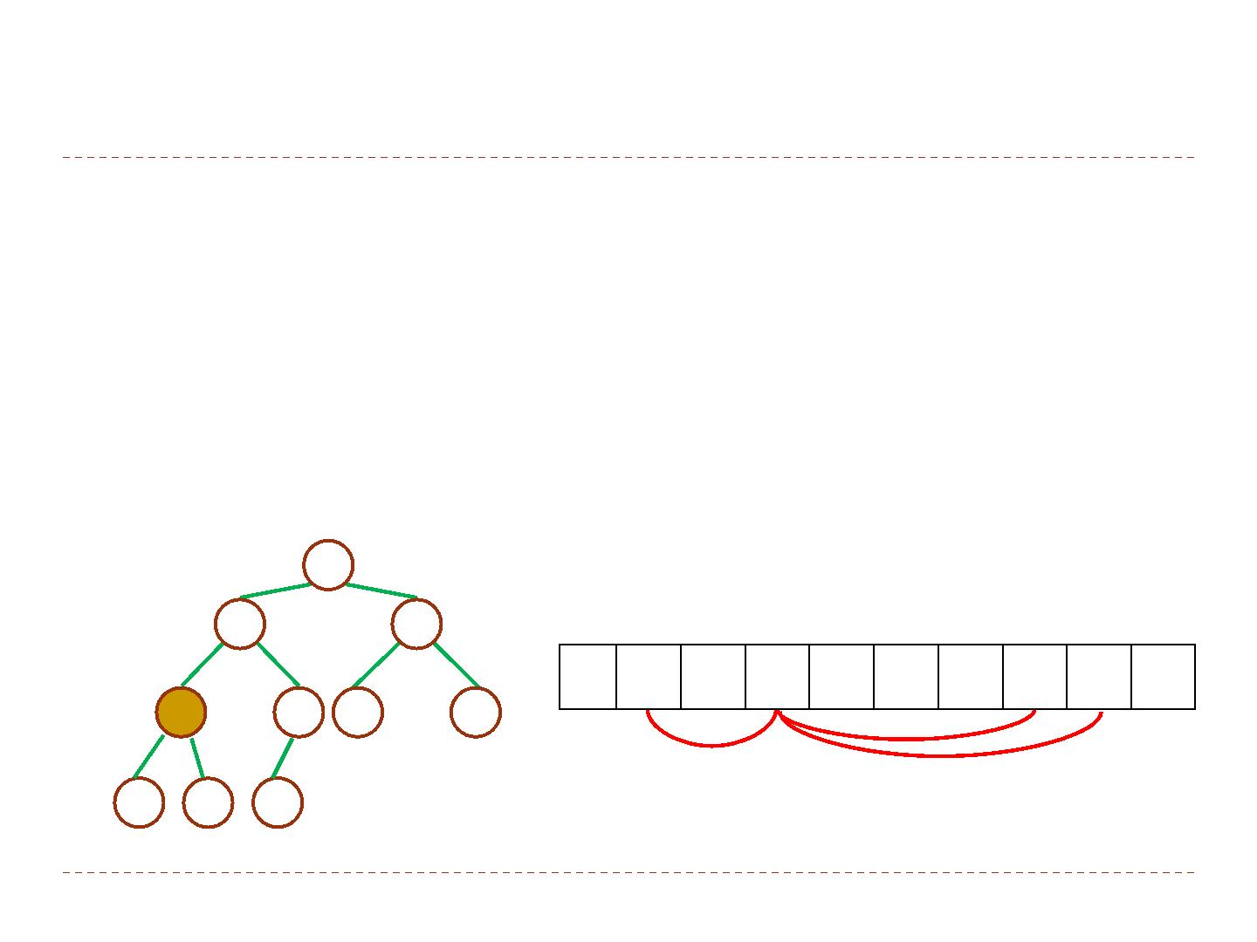
Basic procedures 1/2
` If a complete binary tree with n nodes is represented
sequentially, then for any node with index i, 1 ≤ i ≤ n, we have
` A[1] is the root of the tree
` the parent PARENT(i) is at ⌊i/2⌋ if i ≠ 1
` the left child LEFT(i) is at 2i
` the right child RIGHT(i) is at 2i+1
1
2
16
3
14
10
1 2 3 4 5 6 7 8 9 10
16 14 10 8 7 9 3 2 4 1
4
8
5 6
7 9
7
3
8
9
10
2 4 1

Slide 8
Basic procedures 2/2
` The LEFT procedure can compute 2i in one instruction by simply shifting the binary representation of i left one bit position.
` Similarly, the RIGHT procedure can quickly compute 2i+1 by shifting the binary representation of i left one bit position and adding in a 1 as the low‐order bit.
` The PARENT procedure can compute ⌊i/2⌋ by shifting i right one bit position.

Slide 9
Heap properties
` There are two kind of binary heaps: max‐heaps and min‐heaps.
` In a max‐heap, the max‐heap property is that for every node i
other than the root,
A[PARENT(i) ] ≥ A[i] .
` the largest element in a max‐heap is stored at the root
` the subtree rooted at a node contains values no larger than that
contained at the node itself
` In a min‐heap, the min‐heap property is that for every node i
other than the root,
A[PARENT(i) ] ≤ A[i] .
` the smallest element in a min‐heap is at the root
` the subtree rooted at a node contains values no smaller than that
contained at the node itself

Slide 10
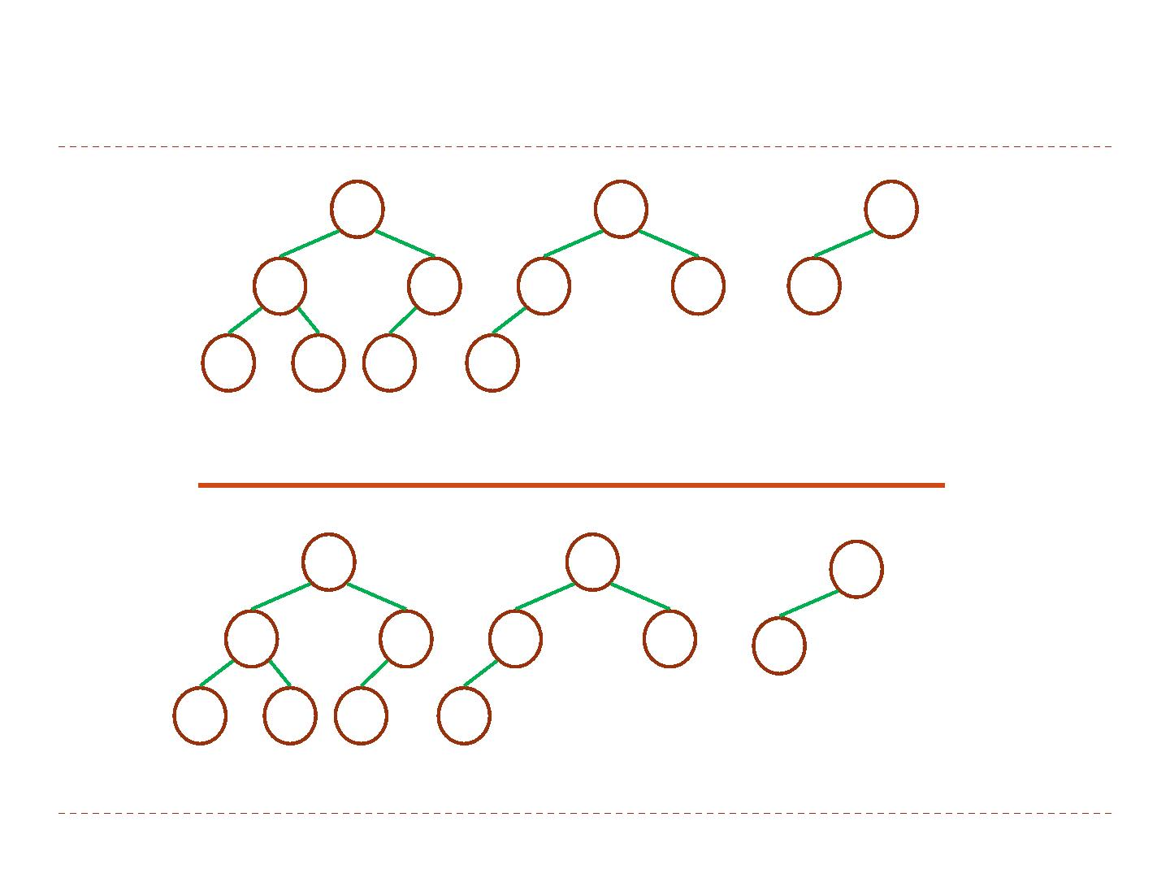
Max and min heaps
14
9
30
12
7
6
3
25
10
8
6
5
Max Heaps
10
2
11
7
4
20
83
21
10
8
6
50
Min Heaps

Slide 11
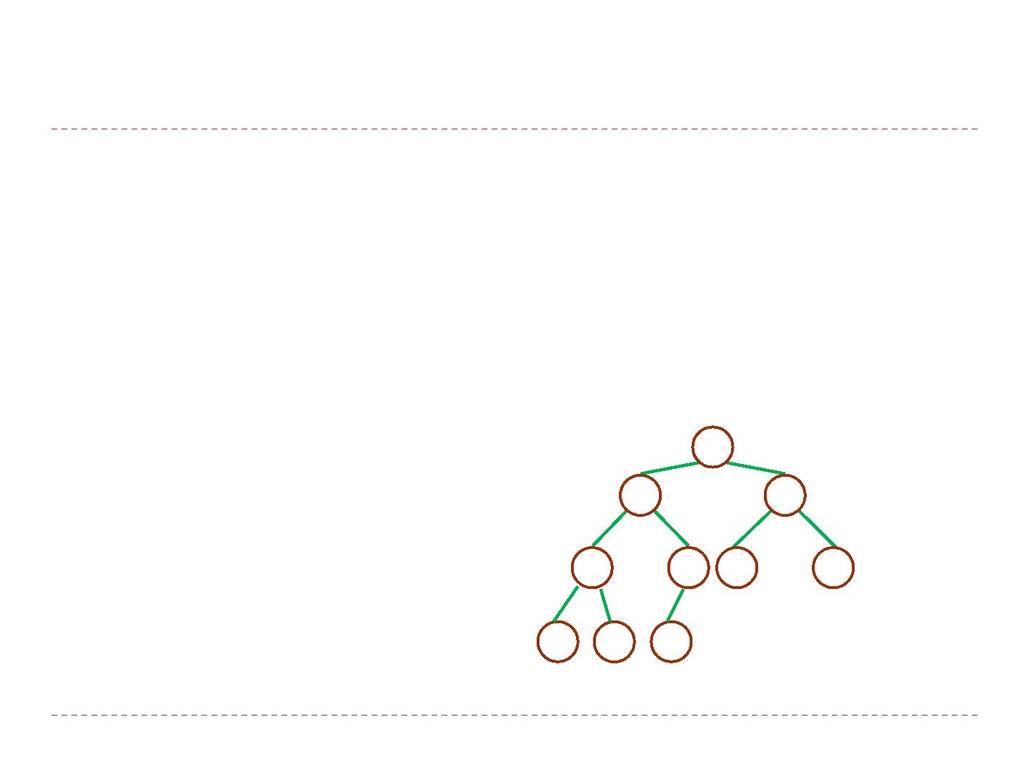
The height of a heap
` The height of a node in a heap is the number of edges on the
longest simple downward path from the node to a leaf, and
the height of the heap to be the height of the root, that is
Θ(lgn).
` For example:
` the height of node 2 is 2
` the height of the heap is 3
1
2
16
3
14
10
4
5 6
7
8
7 9
3
8
9
10
2 4 1

Slide 12








Heap Data Structures
16
h = 3
h = 2 14
10
h = 1
h = 1
8
7
9
3
h = 0
h = 0
2
4 1
Height of node i: Length of the longest simple downward path from i to a leaf
Height of the tree: height of the root

Slide 13
Heap Data Structures
16
d = 0
d = 1 14
10
d = 1
d = 2
8
7
9
3
d = 2
d = 3
2
4 1
Depth of node i: Length of the simple downward path from the root to node i

Slide 14
The remainder of this chapter
` We shall presents some basic procedures in the remainder of this chapter.
` The MAX‐HEAPIFY procedure, which runs in O(lgn) time, is the
key to maintaining the max‐heap property.
` The BUILD‐MAX‐HEAP procedure, which runs in O(n) time,
produces a max‐heap from an unordered input array.
` The HEAPSORT procedure, which runs in O(nlgn) time, sorts an array in place.
` The MAX‐HEAP‐INSERT, HEAP‐EXTRACT‐MAX, HEAP‐INCREASE‐KEY,
and HEAP‐MAXIMUM procedures, which run in O(lgn) time,
allow the heap data structure to be used as a priority queue.

Slide 15
Outline
` Heaps
` Maintaining the heap property
` Building a heap
` The heapsort algorithm
` Priority queues

Slide 16
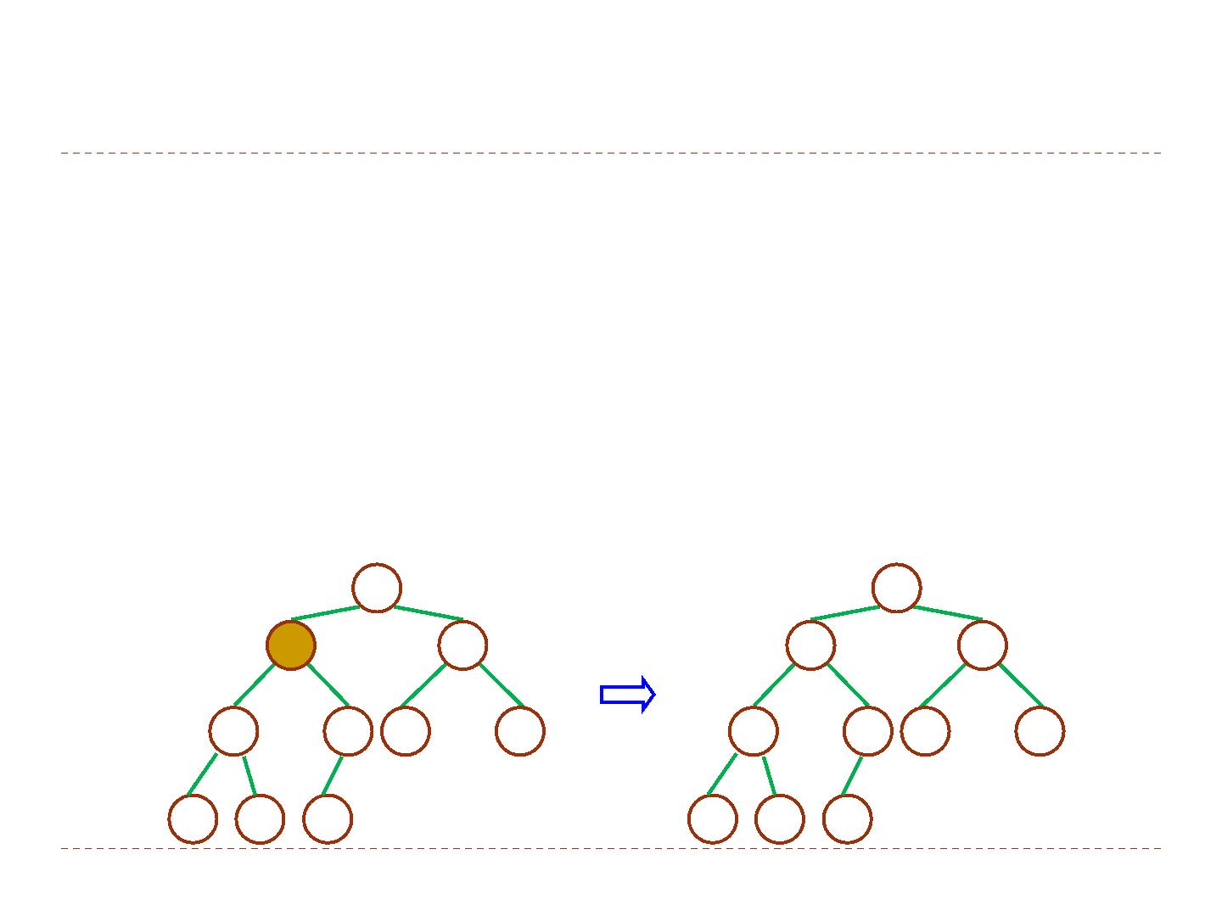
The MAX‐HEAPIFY procedure1/2
` MAX‐HEAPIFY is an important subroutine for manipulating max
heaps.
` Input: an array A and an index i
` Output: the subtree rooted at index i becomes a max heap
` Assume: the binary trees rooted at LEFT(i) and RIGHT(i) are
max‐heaps, but A[i] may be smaller than its children
` Method: let the value at A[i] “float down” in the max‐heap
1
1
2
16
3
2
16
3
i
4
10
M H
14
10
AX‐ EAPIFY
4
5 6
7
4
5 6
7
14
7 9
3
8
7 9
3
8
9
10
8
9
10
2 8 1
2 4 1

Slide 17
The MAX‐HEAPIFY procedure2/2
MAX‐HEAPIFY(A, i)
1.
2.
3.
4.
5.
6.
7.
8.
9.
10.
l ← LEFT(i)
r ← RIGHT(i)
if l ≤ heap‐size[A] and A[l] > A[i]
then largest ← l
else largest ← i
if r ≤ heap‐size[A] and a[r] > A[largest]
then largest ← r
if largest ≠ i
then exchange A[i] ↔ A[largest]
MAX‐HEAPIFY (A, largest)

Slide 18
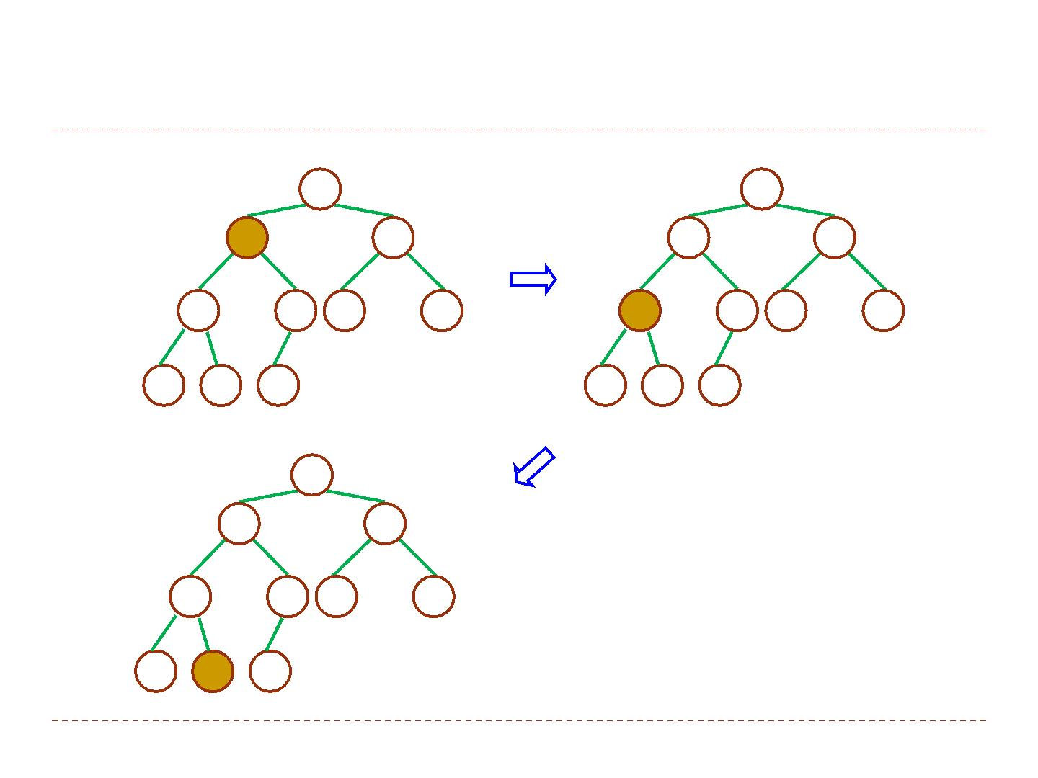
An example of MAX‐HEAPIFY procedure
1
1
2
16
3
2
16
3
i 4
10
14
10
4
5 6
7
4
5 6
7
14
7 9
3
i
4
7 9
3
8
9
10
8
9
10
2 8 1
2 8 1
1
2
14
16
3
10
4
5 6
7
8
7 9
3
8
9
i
10
2 4 1

Slide 19
The time complexity
` It takes Θ(1) time to fix up the relationships among the
elements A[i], A[LEFT(i)], and A[RIGHT(i)].
` Also, we need to run MAX‐HEAPIFY on a subtree rooted at one
of the children of node i.
` The children’s subtrees each have size at most 2n/3
` worst case occurs when the last row of the tree is exactly half full
` The running time of MAX‐HEAPIFY is
T(n) = T(2n/3) + Θ(1)
= O(lg n)
` solve it by case 2 of the master theorem
` Alternatively, we can characterize the running time of MAX‐
HEAPIFY on a node of height h as O(h).

Slide 20








Master Theorem: Reminder T(n) = aT(n/b) + f(n)
_{n}log_{b} a
f (n)
T(n) = Θ(n^{logb a} )
Case 1:
= Ω(n^{ε} )
f (n)
= Θ(lg^{k} n)
_{n}log_{b} a
T(n) = Θ(n^{logb a} lg^{k+1} n)
Case 2:
f (n)
_{n}log_{b} a
= Ω(n^{ε} )
Case 3:
T(n) = Θ( f (n))
and
a f (n/b) ≤ c f (n) for c < 1
Notes:
Master teorem 1 soru sorarim

Slide 21
Outline
` Heaps
` Maintaining the heap property
` Building a heap
` The heapsort algorithm
` Priority queues

Slide 22
Building a Heap
` We can use the MAX‐HEAPIFY procedure to convert an array
A=[1..n] into a max‐heap in a bottom‐up manner.
` The elements in the subarray A[(⌊n/2⌋+1)…n ] are all leaves of
the tree, and so each is a 1‐element heap.
` The procedure BUILD‐MAX‐HEAP goes through the remaining
nodes of the tree and runs MAX‐HEAPIFY on each one.
BUILD‐MAX‐HEAP(A)
1.
2.
3.
heap‐size[A] ← length[A]
for i ← ⌊length[A]/2⌋ downto 1
do MAX‐HEAPIFY(A,i)

Slide 23

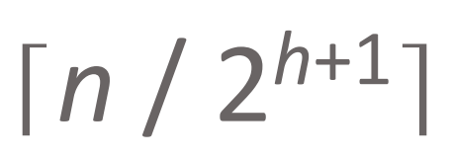
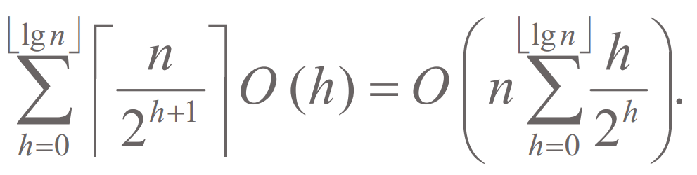
Time Complexity 1/2
` Analysis 1:
` Each call to MAX‐HEAPIFY costs O(lgn), and there are O(n) such
calls.
` Thus, the running time is O(nlgn). This upper bound, through
correct, is not asymptotically tight.
` Analysis 2:
` For an n‐element heap, height is ⌊lgn⌋ and at most
nodes of any height h.
` The time required by MAX‐HEAPIFY when called on a node of
height h is O(h).
⎣lgn⎦ ⎡ ⎤
⎛
⎣lgn⎦
⎞
⎟
.
⎟
∑
n
h
2h
` The total cost is
O h = O ⎜n
∑
⎢ ⎥
( )
⎜
h+
1
h=0
⎢2
⎥
⎝
h=0
⎠

Slide 24
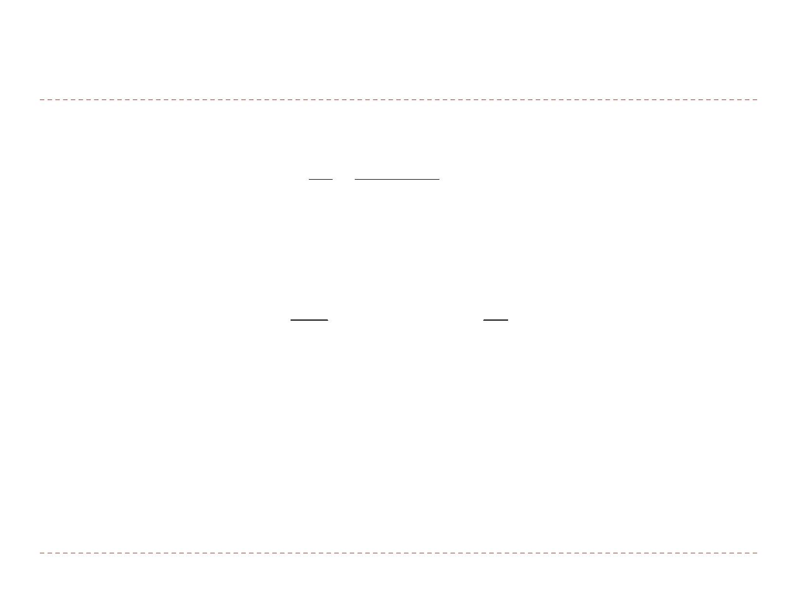
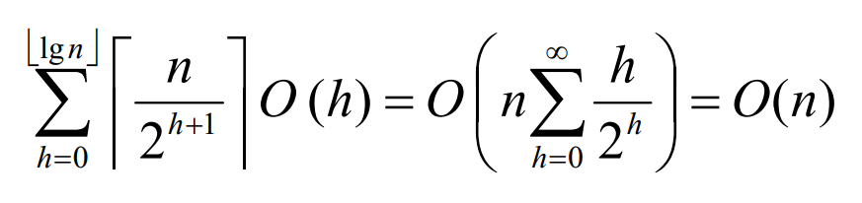
Time Complexity 2/2
` The last summation yields
∞
h
1/ 2
∑
=
= 2
(1−1/ 2)
h
2
h=0
2
` Thus, the running time of BUILD‐MAX‐HEAP can be bounded as
⎣lgn⎦ ⎡ ⎤
⎛
∞
h
⎞
⎟ = O(n)
∑
n
= ⎜
⎝
∑
⎢ ⎥
O (h) O n
h+1
h
2 ⎠
h=0
⎢2 ⎥
h=0
` We can build a max‐heap from an unordered array in linear
time.

Slide 25
Outline
` Heaps
` Maintaining the heap property
` Building a heap
` The heapsort algorithm
` Priority queues

Slide 26
Heapsort Algorithm
The HEAPSORT algorithm
Build a heap on array A[1…n] by calling BUILD-HEAP(A, n)
The largest element is stored at the root A[1]
Put it into its correct final position A[n] by A[1] ↔ A[n]
Discard node n from the heap
Subtrees (S₂ & S₃) rooted at children of root remain as heaps
but the new root element may violate the heap property Make A[1…n − 1] a heap by calling HEAPIFY(A, 1, n − 1)
(5) n ← n − 1
(6) Repeat steps 2−4 until n = 2

Slide 27



Heapsort Algorithm
1
16
HEAPSORT(A, n)
BUILD-MAX-HEAP(A, n)
for i ← n downto 2 do exchange A[1] ↔ A[i] MAX-HEAPIFY(A, 1, i −1)
2
14
3
10
4
8
5
7
6
9
7
3
8
9
10
2
4 1
1 2 3 4 5 6 7 8 9 10
A
16 | 14 | 10 | 8 | 7 | 9 | 3 | 2 | 4 | 1

Slide 28
Heapsort Algorithm
1
1
HEAPSORT(A, n)
BUILD-HEAP(A, n)
for i ← n downto 2 do exchange A[1] ↔ A[i] HEAPIFY(A, 1, i −1)
2
14
3
10
4
8
5
7
6
9
7
3
8
9
10
2
4 16
1 2 3 4 5 6 7 8 9 10
A
1 | 14 | 10 | 8 | 7 | 9 | 3 | 2 | 4 | 16

Slide 29
Heapsort Algorithm
1
14
HEAPSORT(A, n)
BUILD-HEAP(A, n)
for i ← n downto 2 do exchange A[1] ↔ A[i] HEAPIFY(A, 1, i −1)
2
8
3
10
4
4
5
7
6
9
7
3
8
9
10
2
1 16
1 2 3 4 5 6 7 8 9 10
A
14 | 8 | 10 | 4 | 7 | 9 | 3 | 2 | 1 | 16

Slide 30
Heapsort Algorithm
1
1
HEAPSORT(A, n)
BUILD-HEAP(A, n)
for i ← n downto 2 do exchange A[1] ↔ A[i] HEAPIFY(A, 1, i −1)
2
8
3
10
4
4
5
7
6
9
7
3
8
9
14 16
10
2
1 2 3 4 5 6 7 8 9 10
A
1 | 8 | 10 | 4 | 7 | 9 | 3 | 2 | 14 | 16

Slide 31
Heapsort Algorithm
1
10
HEAPSORT(A, n)
BUILD-HEAP(A, n)
for i ← n downto 2 do exchange A[1] ↔ A[i] HEAPIFY(A, 1, i −1)
2
8
3
9
4
4
5
7
6
1
7
3
8
9
14 16
10
2
1 2 3 4 5 6 7 8 9 10
A
10 | 8 | 9 | 4 | 7 | 1 | 3 | 2 | 14 | 16

Slide 32
Heapsort Algorithm
1
2
HEAPSORT(A, n)
BUILD-HEAP(A, n)
for i ← n downto 2 do exchange A[1] ↔ A[i] HEAPIFY(A, 1, i −1)
2
8
3
9
4
4
5
7
6
1
7
3
8
10
9
14 16
10
1 2 3 4 5 6 7 8 9 10
A
2 | 8 | 9 | 4 | 7 | 1 | 3 | 10 | 14 | 16

Slide 33
Heapsort Algorithm
1
9
HEAPSORT(A, n)
BUILD-HEAP(A, n)
for i ← n downto 2 do exchange A[1] ↔ A[i] HEAPIFY(A, 1, i −1)
2
8
3
3
4
4
5
7
6
1
7
2
8
10
9
14 16
10
1 2 3 4 5 6 7 8 9 10
A
9 | 8 | 3 | 4 | 7 | 1 | 2 | 10 | 14 | 16

Slide 34
Heapsort Algorithm
1
2
HEAPSORT(A, n)
BUILD-HEAP(A, n)
for i ← n downto 2 do exchange A[1] ↔ A[i] HEAPIFY(A, 1, i −1)
2
8
3
3
4
4
5
7
6
1
7
9
8
10
9
14 16
10
1 2 3 4 5 6 7 8 9 10
A
2 | 8 | 3 | 4 | 7 | 1 | 9 | 10 | 14 | 16

Slide 35
Heapsort Algorithm
1
8
HEAPSORT(A, n)
BUILD-HEAP(A, n)
for i ← n downto 2 do exchange A[1] ↔ A[i] HEAPIFY(A, 1, i −1)
2
7
3
3
4
4
5
2
6
1
7
9
8
10
9
14 16
10
1 2 3 4 5 6 7 8 9 10
A
8 | 7 | 3 | 4 | 2 | 1 | 9 | 10 | 14 | 16

Slide 36
Heapsort Algorithm
1
1
HEAPSORT(A, n)
BUILD-HEAP(A, n)
for i ← n downto 2 do exchange A[1] ↔ A[i] HEAPIFY(A, 1, i −1)
2
7
3
3
4
4
5
2
6
8
7
9
8
10
9
14 16
10
1 2 3 4 5 6 7 8 9 10
A
1 | 7 | 3 | 4 | 2 | 8 | 9 | 10 | 14 | 16

Slide 37
Heapsort Algorithm
1
7
HEAPSORT(A, n)
BUILD-HEAP(A, n)
for i ← n downto 2 do exchange A[1] ↔ A[i] HEAPIFY(A, 1, i −1)
2
4
3
3
4
1
5
2
6
8
7
9
8
10
9
14 16
10
1 2 3 4 5 6 7 8 9 10
A
7 | 4 | 3 | 1 | 2 | 8 | 9 | 10 | 14 | 16

Slide 38
Heapsort Algorithm
1
2
HEAPSORT(A, n)
BUILD-HEAP(A, n)
for i ← n downto 2 do exchange A[1] ↔ A[i] HEAPIFY(A, 1, i −1)
2
4
3
3
4
1
5
7
6
8
7
9
8
10
9
14 16
10
1 2 3 4 5 6 7 8 9 10
A
2 | 4 | 3 | 1 | 7 | 8 | 9 | 10 | 14 | 16

Slide 39
Heapsort Algorithm
1
4
HEAPSORT(A, n)
BUILD-HEAP(A, n)
for i ← n downto 2 do exchange A[1] ↔ A[i] HEAPIFY(A, 1, i −1)
2
2
3
3
4
1
5
7
6
8
7
9
8
10
9
14 16
10
1 2 3 4 5 6 7 8 9 10
A
4 | 2 | 3 | 1 | 7 | 8 | 9 | 10 | 14 | 16

Slide 40
Heapsort Algorithm
1
1
HEAPSORT(A, n)
BUILD-HEAP(A, n)
for i ← n downto 2 do exchange A[1] ↔ A[i] HEAPIFY(A, 1, i −1)
2
2
3
3
4
4
5
7
6
8
7
9
8
10
9
14 16
10
1 2 3 4 5 6 7 8 9 10
A
1 | 2 | 3 | 4 | 7 | 8 | 9 | 10 | 14 | 16

Slide 41
Heapsort Algorithm
1
3
HEAPSORT(A, n)
BUILD-HEAP(A, n)
for i ← n downto 2 do exchange A[1] ↔ A[i] HEAPIFY(A, 1, i −1)
2
2
3
1
4
4
5
7
6
8
7
9
8
10
9
14 16
10
1 2 3 4 5 6 7 8 9 10
A
3 | 2 | 1 | 4 | 7 | 8 | 9 | 10 | 14 | 16

Slide 42
Heapsort Algorithm
1
1
HEAPSORT(A, n)
BUILD-HEAP(A, n)
for i ← n downto 2 do exchange A[1] ↔ A[i] HEAPIFY(A, 1, i −1)
2
2
3
3
4
4
5
7
6
8
7
9
8
10
9
14 16
10
1 2 3 4 5 6 7 8 9 10
A
1 | 2 | 3 | 4 | 7 | 8 | 9 | 10 | 14 | 16

Slide 43
Heapsort Algorithm
1
2
HEAPSORT(A, n)
BUILD-HEAP(A, n)
for i ← n downto 2 do exchange A[1] ↔ A[i] HEAPIFY(A, 1, i −1)
2
1
3
3
4
4
5
7
6
8
7
9
8
10
9
14 16
10
1 2 3 4 5 6 7 8 9 10
A
2 | 1 | 3 | 4 | 7 | 8 | 9 | 10 | 14 | 16

Slide 44
Heapsort Algorithm
1
1
HEAPSORT(A, n)
BUILD-HEAP(A, n)
for i ← n downto 2 do exchange A[1] ↔ A[i] HEAPIFY(A, 1, i −1)
2
2
3
3
4
4
5
7
6
8
7
9
8
10
9
14 16
10
1 2 3 4 5 6 7 8 9 10
A
1 | 2 | 3 | 4 | 7 | 8 | 9 | 10 | 14 | 16

Slide 45
Heapsort Algorithm
1
1
HEAPSORT(A, n)
BUILD-HEAP(A, n)
for i ← n downto 2 do exchange A[1] ↔ A[i] HEAPIFY(A, 1, i −1)
2
2
3
3
4
4
5
7
6
8
7
9
8
10
9
14 16
10
1 2 3 4 5 6 7 8 9 10
A
1 | 2 | 3 | 4 | 7 | 8 | 9 | 10 | 14 | 16

Slide 47
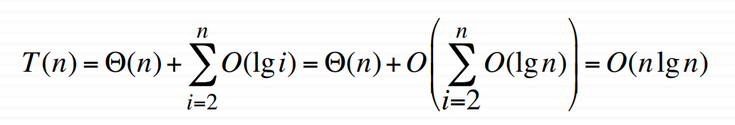
Heapsort Algorithm: Runtime Analysis
HEAPSORT(A, n)
BUILD-HEAP(A, n)
Θ(n)
for i ← n downto 2 do exchange A[1] ↔ A[i] HEAPIFY(A, 1, i −1)
Θ(1)
O(lg(i-1))
n
#
n
&
T (n) = Θ(n) +∑O(lgi) = Θ(n) + O% ∑ O(lg n)( = O(n lg n)
%
(
i=2
∃i=2
′

Slide 48
Heapsort - Notes
Heapsort is a very good algorithm but, a good implementation of quicksort always beats heapsort in practice
However, heap data structure has many popular applications, and it can be efficiently used for implementing priority queues

Slide 49
Outline
` Heaps
` Maintaining the heap property
` Building a heap
` The heapsort algorithm
` Priority queues

Slide 50
Data structures for Dynamic Sets
Consider sets of records having key and
satellite data
key
satellite data
x
record

Slide 51
Operations on Dynamic Sets
Queries: Simply return info;
Modifying operations: Change the set
INSERT(S, x): (Modifying) S← S ∪{x}
DELETE(S, x): (Modifying) S ← S − {x}
MAX(S) / MIN(S): (Query) return x∈S with the largest/smallest key
EXTRACT-MAX(S) / EXTRACT-MIN(S) : (Modifying) return and delete x∈S with the largest/smallest key
SEARCH(S, k): (Query) return x∈S with key[x]= k
SUCCESSOR(S, x) / PREDECESSOR(S, x) : (Query) return y∈S which is the next larger/smaller element after x
Different data structures support/optimize different operations

Slide 52
Priority Queues (PQ)
Supports
INSERT
MAX / MIN
EXTRACT-MAX / EXTRACT-MIN
One application: Schedule jobs on a shared resource
PQ keeps track of jobs and their relative priorities
When a job is finished or interrupted, highest priority job is selected from those pending using EXTRACT-MAX
A new job can be added at any time using INSERT

Slide 53
Priority Queues
Another application: Event-driven simulation
Events to be simulated are the items in the PQ
Each event is associated with a time of occurrence which serves as a key
Simulation of an event can cause other events to be simulated in the future
Use EXTRACT-MIN at each step to choose the next event to simulate
As new events are produced insert them into the PQ using
INSERT

Slide 54
Implementation of Priority Queue
Sorted linked list: Simplest implementation
INSERT
O(n) time
Scan the list to find place and splice in the new item
EXTRACT-MAX
O(1) time
Take the first element
! Fast extraction but slow insertion.

Slide 55
Implementation of Priority Queue
Unsorted linked list: Simplest implementation
INSERT
O(1) time
Put the new item at front
EXTRACT-MAX
O(n) time
Scan the whole list
! Fast insertion but slow extraction
Sorted linked list is better on the average
Sorted list: on the average, scans n/2 elem. per insertion
Unsorted list: always scans n elem. at each extraction

Slide 56
Heap Implementation of PQ
INSERT and EXTRACT-MAX are both O(lg n)
– good compromise between fast insertion but slow extraction and vice versa
EXTRACT-MAX: already discussed HEAP-EXTRACT-MAX
INSERT: Insertion is like that of Insertion-Sort.
Traverses O(lg n) nodes, as HEAPIFY does but makes fewer comparisons and assignments
–HEAPIFY: compares parent with both children
–HEAP-INSERT: with only one
HEAP-INSERT(A, key, n)
n ← n +1
i ← n
while i >1 and A[⎣ i/2 ⎦] < key do
A[i] ← A[⎣ i/2 ⎦ ]
i ← ⎣ i/2 ⎦ A[i] ← key

Slide 57

Example: HEAP-INSERT(A, 15)
1
16
HEAP-INSERT(A, key, n)
n ← n +1
i ← n
while i >1 and A[i/2] < key do
A[i] ← A[i/2 ]
i ← [i/2 ]
A[i] ← key
2
14
3
10
4
8
5
7
6
9
7
3
8
9
10
11
2
4 1
key = 15

Slide 58
Example: HEAP-INSERT(A, 15)
1
16
HEAP-INSERT(A, key, n)
n ← n +1
i ← n
while i >1 and A[i/2] < key do
A[i] ← A[i/2 ]
i ← [i/2 ]
A[i] ← key
2
14
3
10
4
8
5
7
6
9
7
3
8
9
10
11
2
4 1
key = 15

Slide 59
Example: HEAP-INSERT(A, 15)
1
16
HEAP-INSERT(A, key, n)
n ← n +1
i ← n
while i >1 and A[i/2] < key do
A[i] ← A[i/2 ]
i ← [i/2 ]
A[i] ← key
2
14
3
10
4
8
5
7
6
9
7
3
8
9
10
11
2
4 1 7
key = 15

Slide 60
Example: HEAP-INSERT(A, 15)
1
16
HEAP-INSERT(A, key, n)
n ← n +1
i ← n
while i >1 and A[i/2] < key do
A[i] ← A[i/2 ]
i ← [i/2 ]
A[i] ← key
2
14
3
10
4
8
5
14
6
9
7
3
8
9
10
11
2
4 1 7
key = 15

Slide 61
Example: HEAP-INSERT(A, 15)
1
16
HEAP-INSERT(A, key, n)
n ← n +1
i ← n
while i >1 and A[i/2] < key do
A[i] ← A[i/2 ]
i ← [i/2 ]
A[i] ← key
2
15
3
10
4
8
5
14
6
9
7
3
8
9
10
11
2
4 1 7
key = 15

Slide 62
Heap Increase Key
Key value of i-th element of heap is increased from A[i] to key
HEAP-INCREASE-KEY(A, i, key)
if key < A[i] then return error
while i >1 and A[⎣i/2⎦] < key do
A[i] ← A[⎣i/2 ⎦]
i ← ⎣i/2 ⎦
A[i] ← key

Slide 63


Example: HEAP-INCREASE-KEY(A, 9, 15)
1
16
HEAP-INCREASE-KEY(A, i, key)
if key < A[i] then return error
while i >1 and A[i/2] < key do
A[i] ← A[i/2]
i ← [i/2]
A[i] ← key
2
14
3
10
4
8
5
7
6
9
7
3
8
9
10
2
4
1
key = 15

Slide 64

Example: HEAP-INCREASE-KEY(A, 9, 15)
1
16
HEAP-INCREASE-KEY(A, i, key)
if key < A[i] then return error
while i >1 and A[i/2] < key do
A[i] ← A[i/2]
i ← [i/2]
A[i] ← key
2
14
3
10
4
8
5
7
6
9
7
3
8
9
10
2
4
1
key = 15

Slide 65
Example: HEAP-INCREASE-KEY(A, 9, 15)
1
16
HEAP-INCREASE-KEY(A, i, key)
if key < A[i] then return error
while i >1 and A[i/2] < key do
A[i] ← A[i/2]
i ← [i/2]
A[i] ← key
2
14
3
10
4
8
5
7
6
9
7
3
8
9
10
2
8
1
key = 15

Slide 66
Example: HEAP-INCREASE-KEY(A, 9, 15)
1
16
HEAP-INCREASE-KEY(A, i, key)
if key < A[i] then return error
while i >1 and A[i/2] < key do
A[i] ← A[i/2]
i ← [i/2]
A[i] ← key
2
14
3
10
4
14
5
7
6
9
7
3
8
9
10
2
8
1
key = 15

Slide 67
Example: HEAP-INCREASE-KEY(A, 9, 15)
1
16
HEAP-INCREASE-KEY(A, i, key)
if key < A[i] then return error
while i >1 and A[i/2] < key do
A[i] ← A[i/2]
i ← [i/2]
A[i] ← key
2
15
3
10
4
14
5
7
6
9
7
3
8
9
10
2
8
1
key = 15

Slide 68












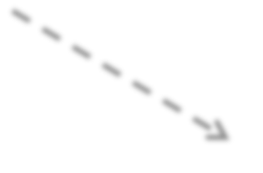





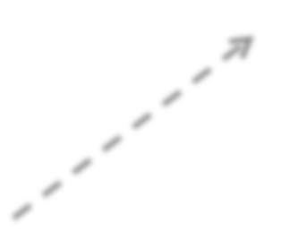

Heap Implementation of PQ
Heap Storage
handle
Abstract Heap Representation
1
Storage in Application
key
data H-index
a
16
14 |  | 2
3 |  | 7
7 |  | 5
10 |  | 3
* |  | --
4 |  | 9
8 |  | 4
* |  | --
9 |  | 6
16 |  | 1
2 |  | 8
1
2
3
4
5
6
7 b
8
9
2
14
3
10
j
b c
a
d
d e f g h i j k
g
4
8
5
7
6
9
7
3
c
i
8
9
4
k
2
f

Slide 69
Summary: Max Heap
Heapify(A, i)
Works when both child subtrees of node i are heaps “Floats down” node i to satisfy the heap property Runtime: O(lgn)
Max (A, n)
Returns the max element of the heap (no modification) Runtime: O(1)
Extract-Max (A, n)
Returns and removes the max element of the heap
Fills the gap in A[1] with A[n], then calls Heapify(A,1) Runtime: O(lgn)

Slide 70
Summary: Max Heap
Build-Heap(A, n)
Given an arbitrary array, builds a heap from scratch Runtime: O(n)
Min(A, n)
How to return the min element in a max-heap? Worst case runtime: O(n)
because ~half of the heap elements are leaf nodes Instead, use a min-heap for efficient min operations
Search(A, x)
For an arbitrary x value, the worst-case runtime: O(n) Use a sorted array instead for efficient search operations

Slide 71
Summary: Max Heap
Increase-Key(A, i, x)
Increase the key of node i (from A[i] to x) “Float up” x until heap property is satisfied Runtime: O(lgn)
Decrease-Key(A, i, x)
Decrease the key of node i (from A[i] to x) Call Heapify(A, i)
Runtime: O(lgn)

Slide 72



Example Problem: Phone Operator
A phone operator answering n phones
Each phone i has x_{i} people waiting in line for their calls to be answered.
Phone operator needs to answer the phone with the largest number of people waiting in line.
New calls come continuously, and some people hang up after waiting.

Slide 73

Solution
Step 1: Define the following array:
A
key id
A[i]: the i^{th} element in heap
1
A[i].id: the index of the
corresponding phone
A[i].key: # of people waiting in line for phone with index A[i].id
n

Slide 74
Solution
Step 2: Build-Max-Heap (A, n)
Execution:
When the operator wants to answer a phone: id = A[1].id
Decrease-Key(A, 1, A[1].key-1)
answer phone with index id
When a new call comes in to phone i: Increase-Key(A, i, A[i].key+1)
When a call drops from phone i: Decrease-Key(A, i, A[i].key-1)

